Slide 1
School Friendships
How complicated can it be?
Amanda roach October 2019
Yezfidar family services

Slide 2
Our job as parents
Raise our children to be good adults and citizens by:
Giving them unconditional love
Providing shelter, food, warmth, safety from harm
Developing connection to family and other people
A sense of belonging and worthiness
Fostering trust in relationships and help-seeking
Building confidence to be independent in the world

Slide 3
Other qualities we might want them to have include:
Communicate effectively
Being able to express feelings and label them
Courage to have a go, with no guarantee of success
Courage to be imperfect
Courage to be vulnerable when needed
Compassion to be kind and think about others
Willingness to share

Slide 4
The job of a child is to become an adult
The job of school and family, working together, is to take a baby from:
Being a child who is dependent
To an adolescent who is forming their identity
To become the fully responsible adult we hoped for them to be

Slide 5
So why are friendships important?
Most learning takes place within a social context – all kinds of learning:
* Development of self esteem
* Sense of belonging
* Having fun, and the good body chemicals released by this
* Sharing interests
* Building emotional skills and awareness
* Sensitivity to the thoughts, feelings and wellness of others
* Building resilience
* Prevention of future mental illness

Slide 6
And very importantly:
Building Life Skills
Getting along with other people through co-operation
Independence
Sorting out conflict
Listening and Problem-solving
Shielding against social & emotional difficulties later in life
[1 in 7 children aged 4-11 have symptoms of an emerging mental illness]

Slide 7
Home life is important
This is where children first learn to:
Listen and be listened to
Take turns and learn about rules
Talk to problem-solve
Express and label feelings
Handle/manage feelings and big emotions
Understand that being listened to and getting a hug from a significant adult may be all you need to feel OK
Self-soothing

Slide 8
Helping your child to make friends
* Get to know their friends at school:
Importance in your child’s life, personality or influence, families, possibility for invitations and play dates
Ask your child’s teacher if you aren’t sure and need some guidance on this
* Help out at school if possible: canteen, sports days, in the classroom, craft activities, excursions
* If they are less confident:
Shorten playdates
Help choose activities they’ll enjoy
Be available to help out in the visit
Give time and space as needed

Slide 9
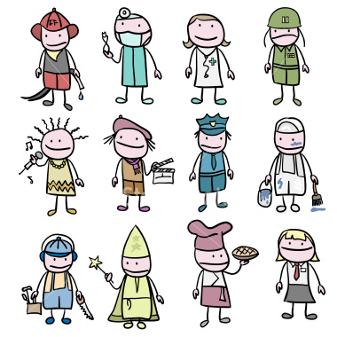
REMEMBER #1
All kids are different, so some need less friends than others
AND will be happy with that

Slide 10
Other ideas
These are helpful for both confident kids as well as those who may be hesitant:
Find extra-curricular activities – sport, dance, art, volunteering – these are opportunities to meet others with similar interests
Practice social skills if needed – introductions, inviting someone to have a turn, asking questions
Arrange play dates from these activities as well as school – widen their social world
Up-skill your child in games, activities so that they can participate and increase fun or enjoyment factors
Suggest they take an activity to school for others to participate in
Encourage them to ask other kids to help them out – they often have good ideas
Always ask your child in the first instance “What were some of the good/happy things that happened at school today?”
Discuss any issues with their teacher

Slide 11
Sooooooooo……..when do I know there is a friendship problem?????
Your child may be generally unhappy; watch their demeanor, listen for any sad or worried words spoken
They may not be eating lunch or food you supply
There may be injuries not realistically explained
They may be losing belongings or things get broken
Your child may be demonstrating avoidant behaviour, such as saying they feel sick, not wanting to go to school until just on the bell
There may be outright school refusal
There may be evidence on social media if they are using this

Slide 12
“Frenemies”
This is a common feature of childhood, adolescent and even adult relationships
Usually these are “friends” who are destructive in some way; they may tell stories behind your back, “use” you in some way (such as for money), manipulate you to get an outcome they want, or generally cause you to have negative feelings and thoughts, making you unhappy with them or yourself, and your responses to them.
Some things to consider:
# It’s important that your child can communicate openly about this problem
# Is your child encouraging this behaviour, not giving clear messages to the “frenemey” that they dislike what they are doing?
# Problem-solve with your child what is actually going on – where, what, when, who, how…….Look at what happens, before, during and as a consequence of the actions

Slide 13
More ideas for parents, dealing with “frenemies”
This is an area kids will need a lot of support help with. It’s not quite bullying, but not far from it either as it is more subtle
If it is causing a lot of grief, then it is best to end the friendship.
This is best done in a very clear and direct manner and you may need to practice this with your child [e.g. “I don’t like the way you always talk about me behind my back, it makes me really unhappy. I don’t want to be your friend any more.”
Realise that there will be consequences because of this action: your child may be more relaxed and happy because they have taken a stand; perhaps fall-out with the “frenemy” becoming a bully. This will need to be dealt with as for any bullying behaviour. PLEASE MONITOR THIS!
Do not confront the “frenemy” or the family; your child needs to feel empowered to deal with this situation. They need your support, not your emotional outburst.
Don’t put additional consequences on your child which will have an opposite affect, such as criticising the “frenemy” or banning any contact with them.
Bottom line is that the toxic relationship needs to change by ending it at this point.

Slide 14
BULLYING
This set of behaviours is often the most worrying.
This can be devastating for your child’s self esteem. If you suspect this is happening:
Listen to your child and get a good sense of what’s happening
Ask questions for information, but not to “interrogate”
Stay calm; be a good role model and tell them you will help problem-solve this
Summarise the problem to demonstrate you listened and understand
Reassure them it is normal to feel upset
Make sure your child understands that it is not their fault

Slide 15
More………………..
You could relate a friendship problem of your own
Reassure your child that they can always talk with you
Ask the school’s teachers, counsellor or librarian about good books or material that could help both you and your child
Praise your child for talking to you about what has happened or what is worrying them
Let them know that bullying behaviour is not OK
Avoid negative comments or actions
Explain to your child some of the reasons that other children become bullies, such as not knowing how to be nice to others, trying to make themselves feel better when they have a problem, or even not knowing this is bullying

Slide 16
Work TOGETHER with the school
It’s important to have a consolidated plan!
Make an appointment with your child’s teacher to discuss it
Make sure it is in a private location
Be calm presenting your concerns – you want their help
Ask for the teacher’s view
Be assertive but not angry or accusing if you feel “fobbed off”
End the meeting with an agreed plan
Follow up, keep in touch

Slide 17
REMEMBER #2
Results don’t happen overnight!

Slide 18
Ideas for your child to try
It’s important for your child to have some strategies to use if they are being harassed or bullied.
This gives them some feelings of taking control, problem-solving and is generally good practice for events they’ll likely experience throughout life.
Ignore it
Move away from the bully
Tell the bully (loudly) to stop – especially if they are teasing or name-calling
Avoid high-risk places, without avoiding where you need to be
Stay around other people (other friends, adults, the teacher)
Ask others to help (a bully is less likely to strike then)
Tell the teacher or other grown-ups, especially if there is physical assault or theft
Check with your child what they have already done, if anything has worked before

Slide 19
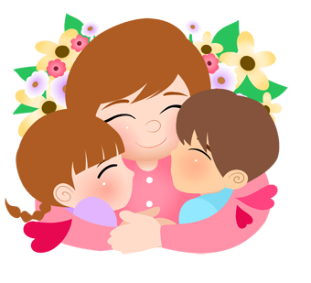
REMEMBER #3
Your kids learn mostly from observing you -
Be a good role model!
Always treat others with kindness and respect
This Photo by Unknown Author is licensed under CC BY-SA-NC

Slide 20
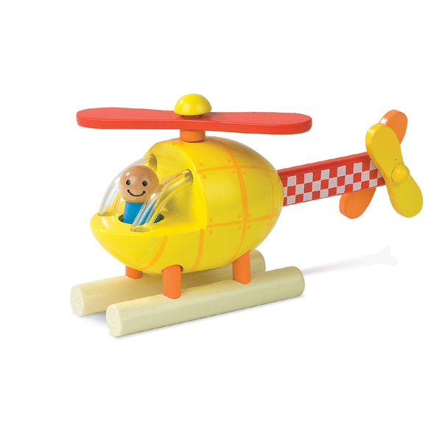
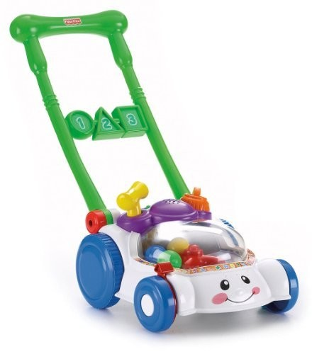
REMEMBER #4
Your child doesn’t need you to be a
Lawn mower, or
Helicopter parent
The idea is to give them the skills they will need to live THEIR life!

Slide 21
REMEMBER #5
A handout for you!
This applies to all children, of any age

Slide 22
Any Questions???

